Slide 1
Analysis of Algorithms
Algorithms & Data Structures
ITCS 6114/8114
Dr. Dewan Tanvir Ahmed
Department of Computer Science
University of North Carolina at Charlotte

Slide 2
Analysis of Algorithms
Input
Algorithm
Output
An algorithm is a step-by-step procedure for
solving a problem in a finite amount of time.

Slide 3
Running Time (§1.1)
The running time of an algorithm typically grows with the input size.
Average case time is often difficult to determine.
We focus on the worst case running time.
Easier to analyze
Crucial to applications such as games, finance and robotics

Slide 4
Experimental Studies (§ 1.6)
Write a program implementing the algorithm
Run the program with inputs of varying size and composition
Use a method like System.currentTimeMillis() to get an accurate measure of the actual running time
Plot the results

Slide 5
Limitations of Experiments
It is necessary to implement the algorithm, which may be difficult
Results may not be indicative of the running time on other inputs not included in the experiment.
In order to compare two algorithms, the same hardware and software environments must be used

Slide 6
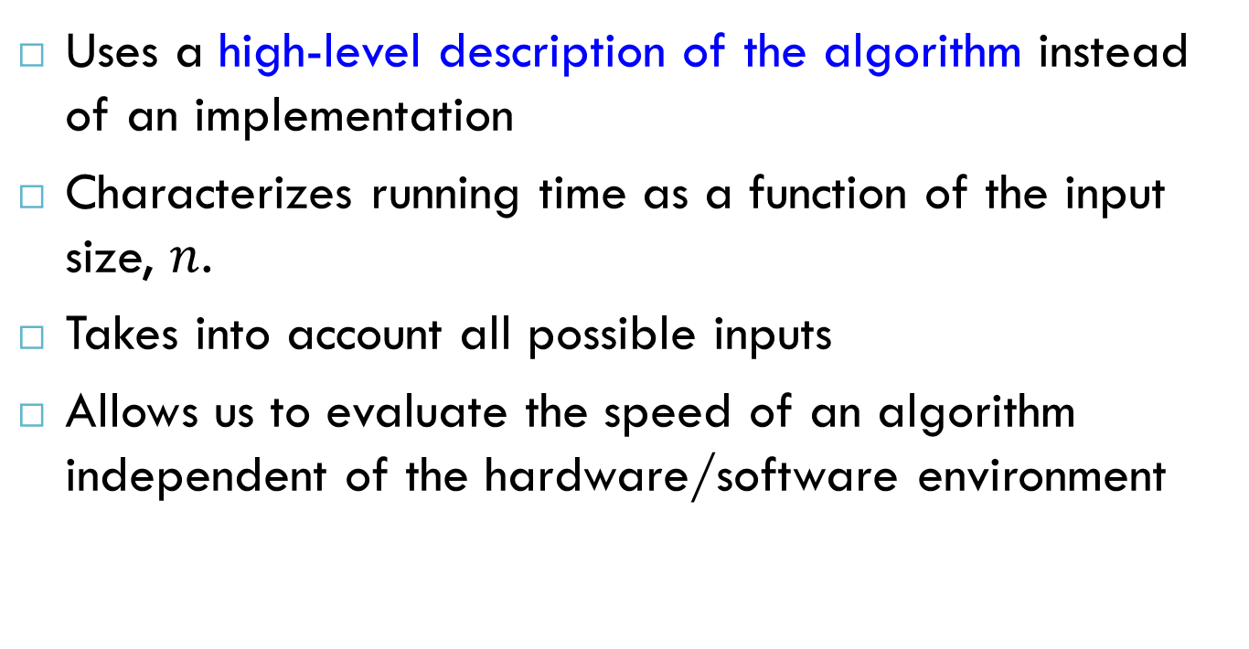
Theoretical Analysis
Uses a high-level description of the algorithm instead of an implementation
Characterizes running time as a function of the input size, $n$.
Takes into account all possible inputs
Allows us to evaluate the speed of an algorithm independent of the hardware/software environment

Slide 7
Pseudocode (§1.1)
High-level description of an algorithm
More structured than English prose
Less detailed than a program
Preferred notation for describing algorithms
Hides program design issues
Example: find max element of an array
Algorithm arrayMax(A, n)
Input array A of n integers
Output the maximum element of A
currentMax ← A[0]
for i ← 1 to n − 1 do
if A[i] > currentMax then
currentMax ← A[i]
return currentMax

Slide 8
The Random Access Machine (RAM) Model
A CPU
A potentially unbounded bank of memory cells, each of which can hold an arbitrary number or character
2
1
0
Memory cells are numbered and accessing any cell in memory takes unit time.

Slide 9
Primitive Operations
Basic computations performed by an algorithm
Identifiable in pseudocode
Largely independent from the programming language
Exact definition not important (we will see why later)
Assumed to take a constant amount of time in the RAM model
Examples:
Evaluating an expression
Assigning a value to a variable
Indexing into an array
Calling a method
Returning from a method

Slide 10
Counting Primitive Operations (§1.1)
By inspecting the pseudocode, we can determine the maximum number of primitive operations executed by an algorithm, as a function of the input size
Algorithm arrayMax(A, n)
# operations
currentMax ← A[0] 2
for i ← 1 to n − 1 do 2 + n
if A[i] > currentMax then 2(n − 1)
currentMax ← A[i] 2(n − 1)
{ increment counter i } 2(n − 1)
return currentMax 1
Total 7n − 1

Slide 11
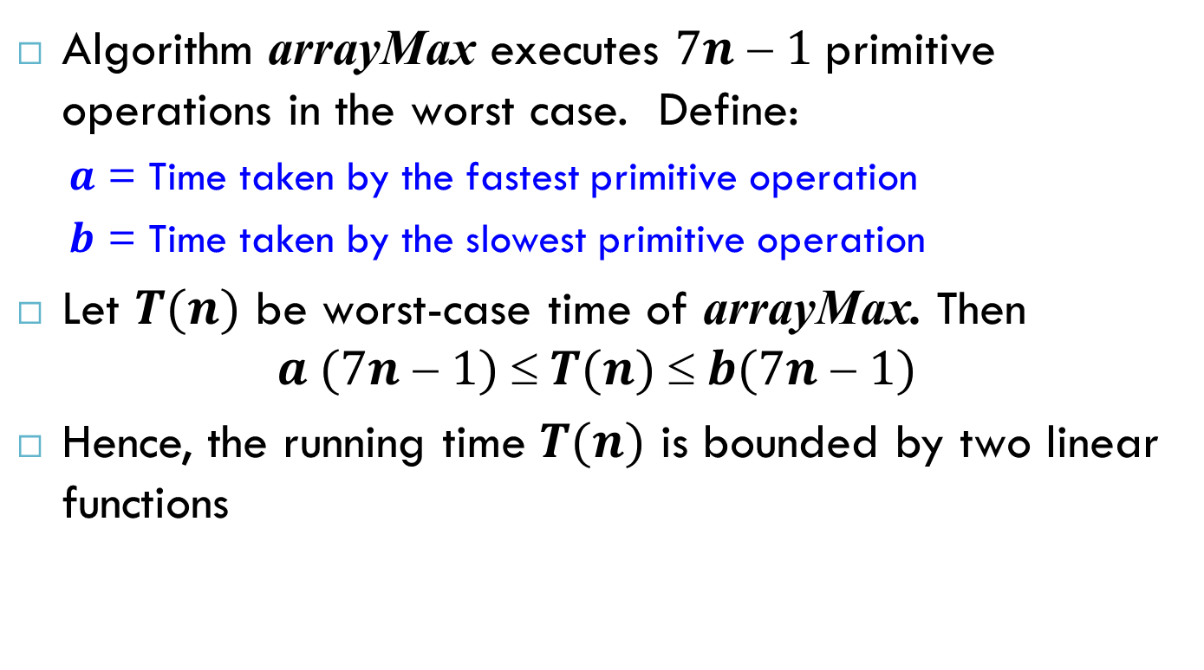
Estimating Running Time
Algorithm arrayMax executes $7n  1$primitive operations in the worst case. Define:
$a$ = Time taken by the fastest primitive operation
$b$ = Time taken by the slowest primitive operation
Let $T(n)$ be worst-case time of arrayMax. Then $a (7n  1)  T(n)  b(7n  1)$
Hence, the running time $T(n)$ is bounded by two linear functions

Slide 12
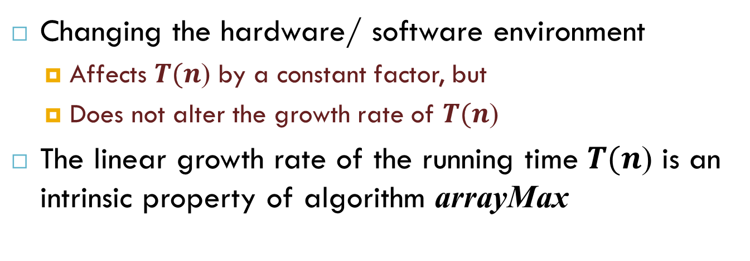
Growth Rate of Running Time
Changing the hardware/ software environment
Affects $T(n$) by a constant factor, but
Does not alter the growth rate of $T(n$)
The linear growth rate of the running time $T(n$) is an intrinsic property of algorithm arrayMax

Slide 13
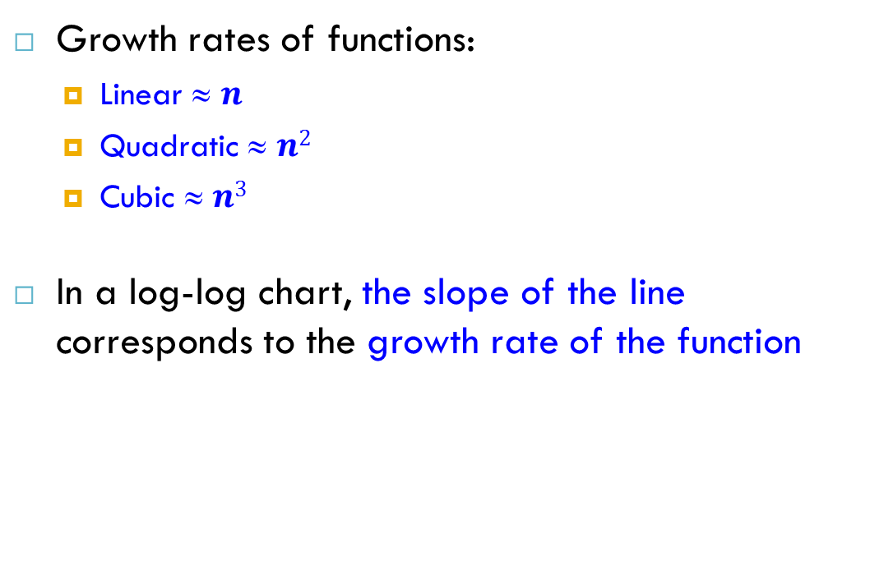
Growth Rates
Growth rates of functions:
Linear ≈ $n$
Quadratic ≈ $n2$
Cubic ≈ $n3$
In a log-log chart, the slope of the line corresponds to the growth rate of the function

Slide 14
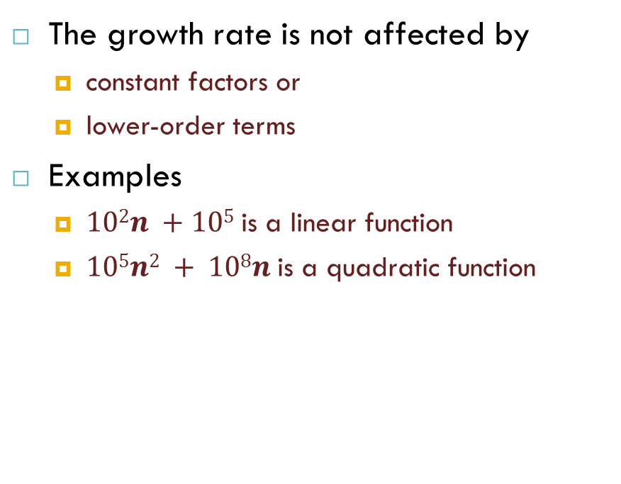
Constant Factors
The growth rate is not affected by
constant factors or
lower-order terms
Examples
$102n +105$is a linear function
$105n2 + 108n$is a quadratic function

Slide 15
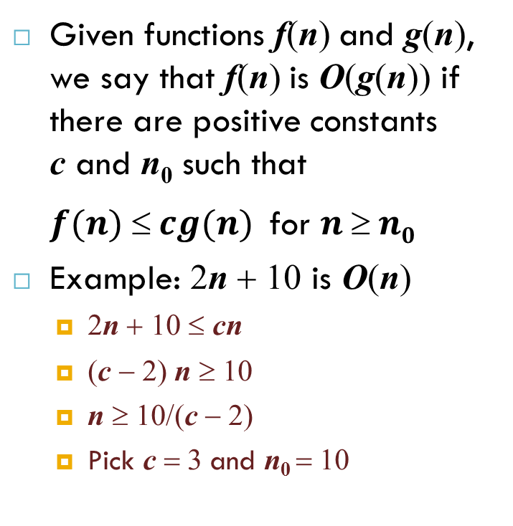
Big-Oh Notation (§1.2)
Given functions f(n) and g(n), we say that f(n) is O(g(n)) if there are positive constants c and n₀ such that
$f(n)  cg(n)$for $n  n0$
Example: 2n + 10 is O(n)
2n + 10 ≤ cn
(c − 2) n ≥ 10
n ≥ 10/(c − 2)
Pick c = 3 and n₀ = 10

Slide 16
Big-Oh Example
Example: the function n² is not O(n)
n² ≤ cn
n ≤ c
The above inequality cannot be satisfied since c must be a constant

Slide 17
More Big-Oh Examples
7n-2
7n-2 is O(n)
need c > 0 and n₀ ≥ 1 such that 7n-2 ≤ c•n for n ≥ n₀
this is true for c = 7 and n₀ = 1
3n³ + 20n² + 5
3n³ + 20n² + 5 is O(n³)
need c > 0 and n₀ ≥ 1 such that 3n³ + 20n² + 5 ≤ c•n³ for n ≥ n₀
this is true for c = 4 and n₀ = 21
3 log n + log log n
3 log n + log log n is O(log n)
need c > 0 and n₀ ≥ 1 such that 3 log n + log log n ≤ c•log n for n ≥ n₀
this is true for c = 4 and n₀ = 2

Slide 18
Big-Oh and Growth Rate
The big-Oh notation gives an upper bound on the growth rate of a function
The statement “f(n) is O(g(n))” means that the growth rate of f(n) is no more than the growth rate of g(n)
We can use the big-Oh notation to rank functions according to their growth rate
 | f(n) is O(g(n)) | g(n) is O(f(n))
g(n) grows more | Yes | No
f(n) grows more | No | Yes
Same growth | Yes | Yes

Slide 19
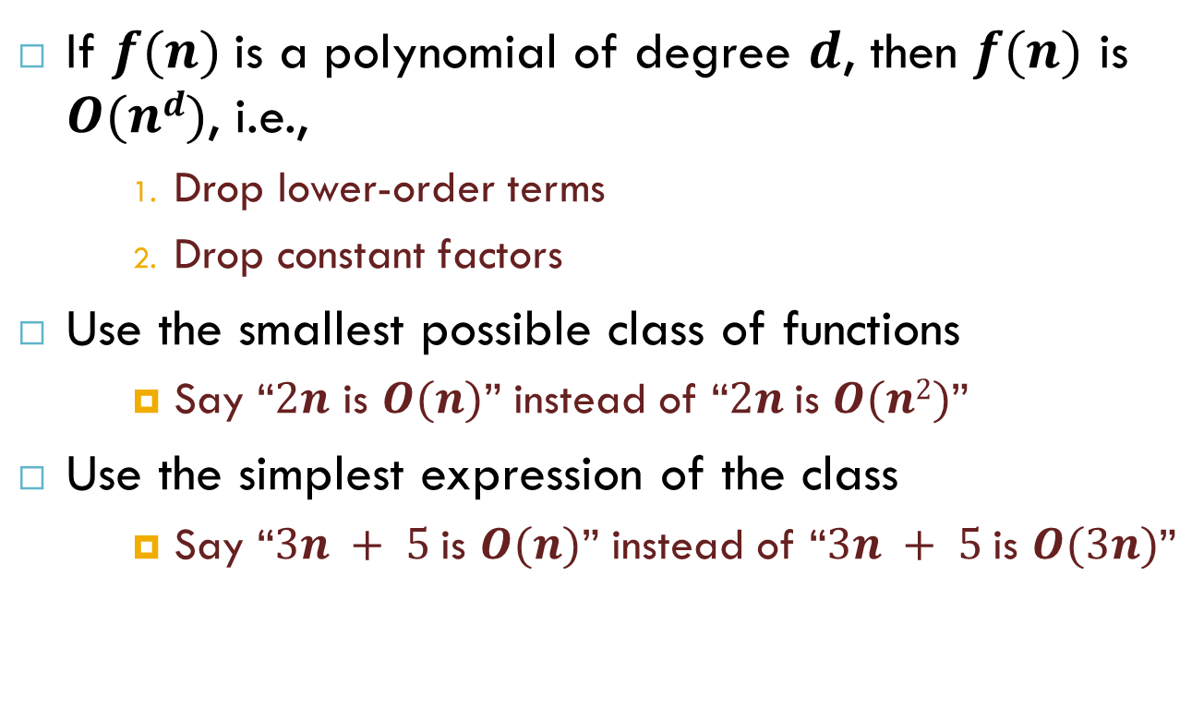
Big-Oh Rules
If $f(n)$is a polynomial of degree $d$, then $f(n)$ is $O(nd)$, i.e.,
Drop lower-order terms
Drop constant factors
Use the smallest possible class of functions
Say “$2n$ is $O(n)$” instead of “$2n$is $O(n2)$”
Use the simplest expression of the class
Say “$3n + 5$is $O(n)$” instead of “$3n + 5$is $O(3n)$”

Slide 20
Asymptotic Algorithm Analysis
The asymptotic analysis of an algorithm determines the running time in big-Oh notation
To perform the asymptotic analysis
We find the worst-case number of primitive operations executed as a function of the input size
We express this function with big-Oh notation
Example:
We determine that algorithm arrayMax executes at most 7n − 1 primitive operations
We say that algorithm arrayMax “runs in O(n) time”
Since constant factors and lower-order terms are eventually dropped anyhow, we can disregard them when counting primitive operations

Slide 21
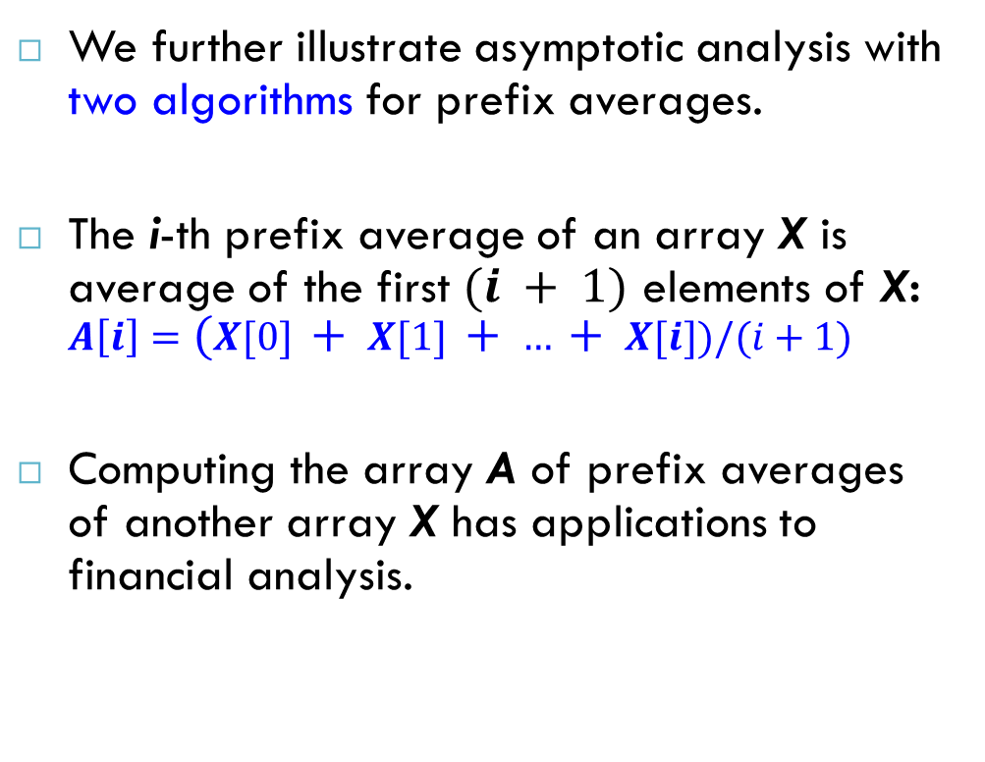
Computing Prefix Averages
We further illustrate asymptotic analysis with two algorithms for prefix averages.
The i-th prefix average of an array X is average of the first $(i + 1)$ elements of X:
$$A\left[i\right]=(X[0] + X[1] + … + X[i])/(i+1)$$
Computing the array A of prefix averages of another array X has applications to financial analysis.

Slide 22
Prefix Averages (Quadratic)
The following algorithm computes prefix averages in quadratic time by applying the definition
Algorithm prefixAverages1(X, n)
Input array X of n integers
Output array A of prefix averages of X
A ← new array of n integers
for i ← 0 to n − 1 do
s ← X[0]
for j ← 1 to i do
s ← s + X[j]
A[i] ← s / (i + 1)
return A
n
n + 1
n
1 + 2 + …+ (n − 1) + n
1 + 2 + …+ (n − 1)
n
1

Slide 23
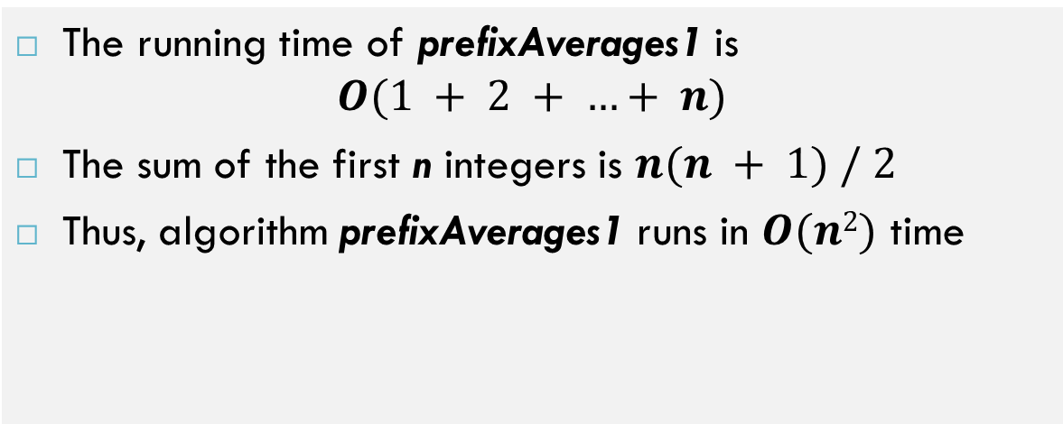
Arithmetic Progression
The running time of prefixAverages1 is $O(1 + 2 + …+ n)$
The sum of the first n integers is $n(n + 1) / 2$
Thus, algorithm prefixAverages1 runs in $O(n2)$ time

Slide 24
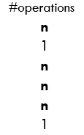
Prefix Averages (Linear)
The following algorithm computes prefix averages in linear time by keeping a running sum
Algorithm prefixAverages2 runs in O(n) time
Algorithm prefixAverages2(X, n)
Input array X of n integers
Output array A of prefix averages of X #operations
A ← new array of n integers n
s ← 0 1
for i ← 0 to n − 1 do n
s ← s + X[i] n
A[i] ← s / (i + 1) n
return A 1
n + 1

Slide 25
Intuition for Asymptotic Notation
Big-Oh
f(n) is O(g(n)) if f(n) is asymptotically less than or equal to g(n)
big-Omega
f(n) is Ω(g(n)) if f(n) is asymptotically greater than or equal to g(n)
big-Theta
f(n) is Θ(g(n)) if f(n) is asymptotically equal to g(n)
little-oh
f(n) is o(g(n)) if f(n) is asymptotically strictly less than g(n)
little-omega
f(n) is ω(g(n)) if is asymptotically strictly greater than g(n)

Slide 26
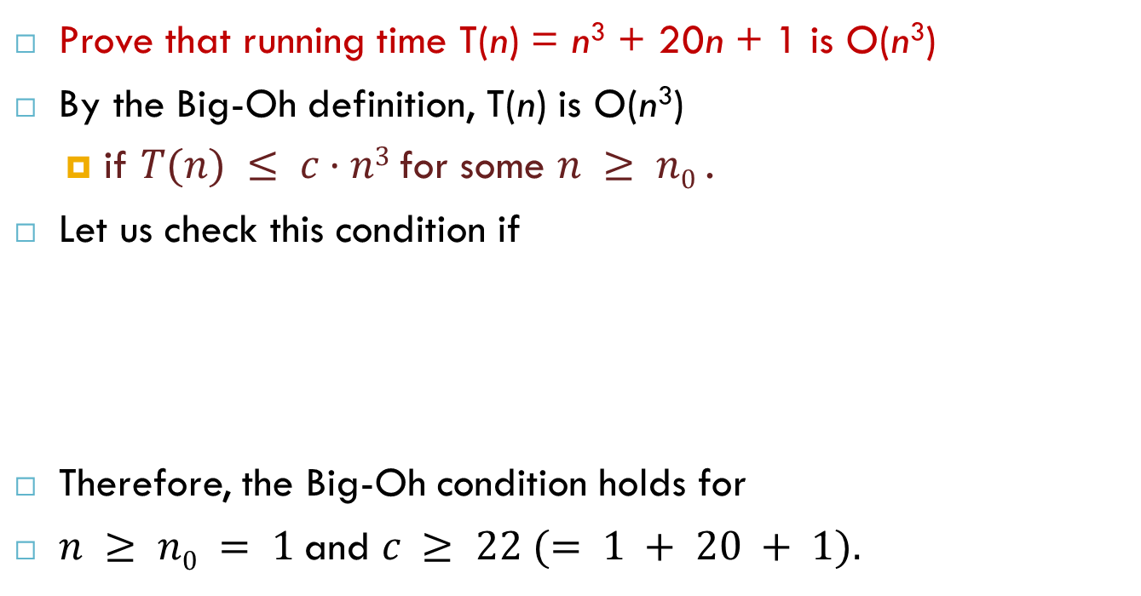
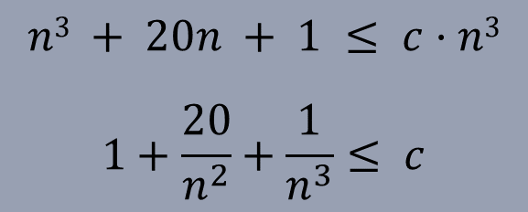
Example 1
Larger values of n₀ result in smaller factors c (e.g., for n₀ = 10 c ≥ 1.201 and so on) but in any case the above statement is valid.

Slide 27
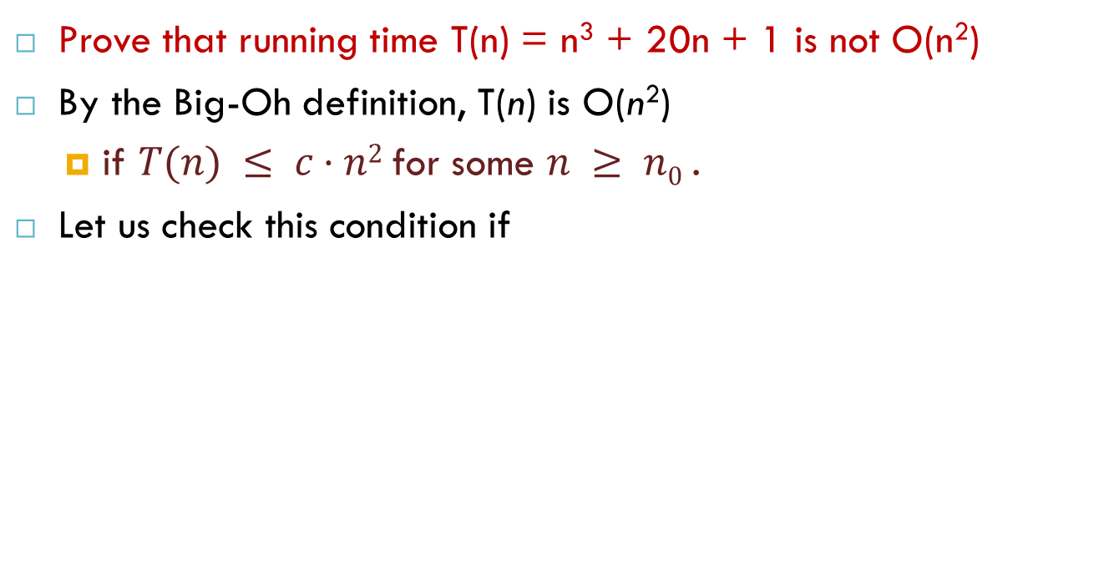
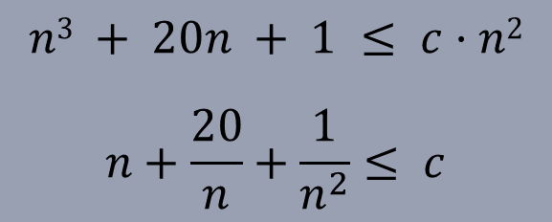
Example 2
Therefore, the Big-Oh condition cannot hold (the left side of the latter inequality is growing infinitely, so that there is no such constant factor c).

Slide 28

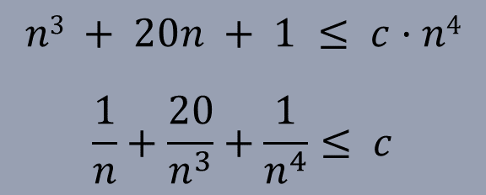
Example 3
Larger values of n₀ result in smaller factors c (e.g., for n₀ = 10 c ≥ 0.10201 and so on) but in any case the above statement is valid.

Slide 29
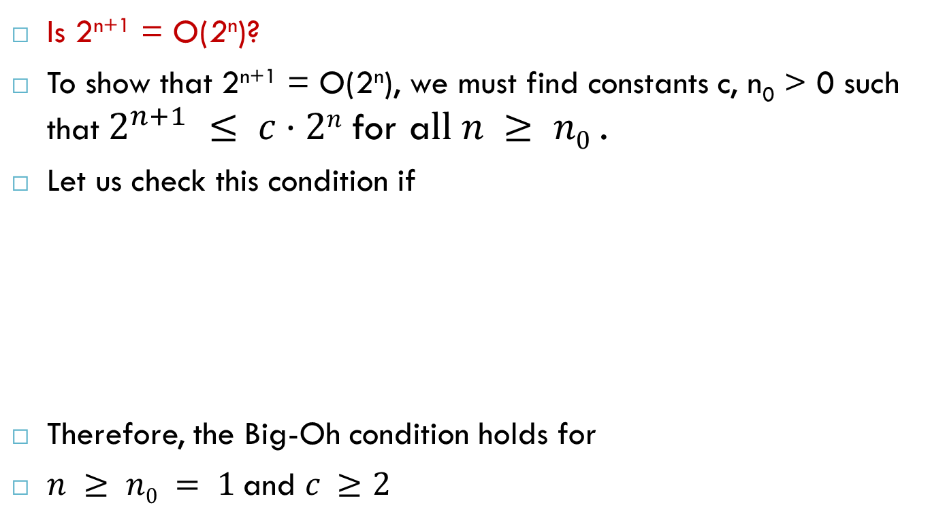
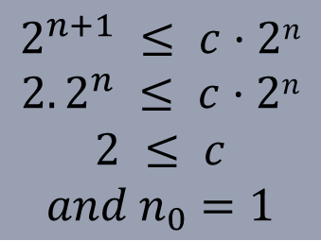
Example 4

Slide 30
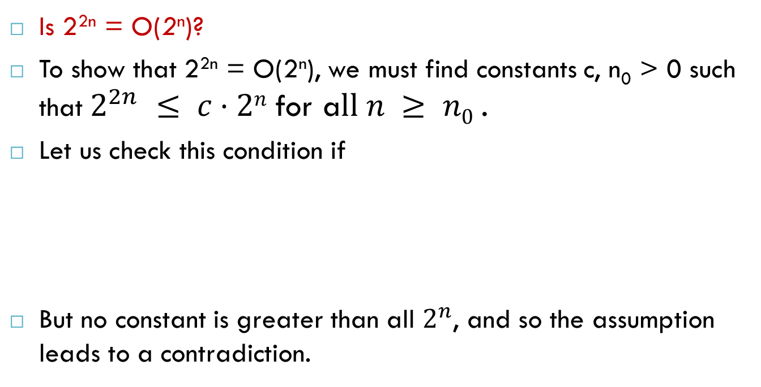
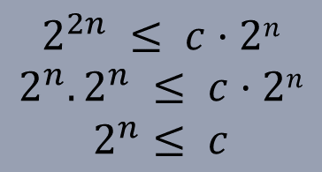
Example 5

Slide 31
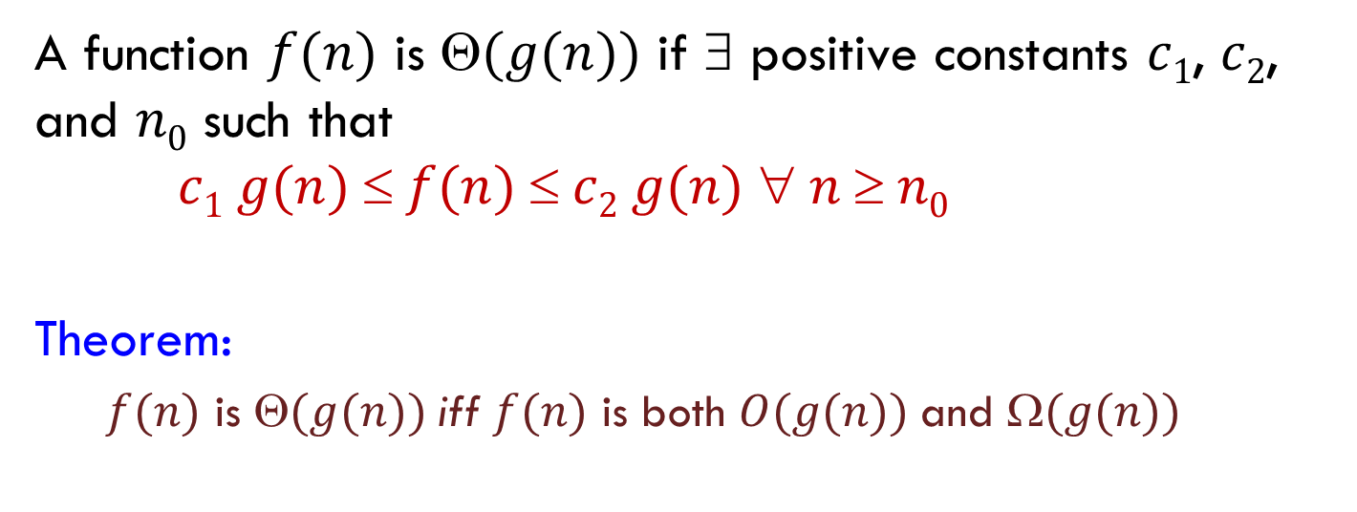
Asymptotic Tight Bound
A function $f(n)$ is $(g(n))$ if $$ positive constants $c1$, $c2$, and $n0$ such that $c1 g(n)  f(n)  c2 g(n)  n  n0$
Theorem:
$f(n)$ is $(g(n))$iff $f(n)$ is both $O(g(n))$and $(g(n))$

Slide 32
Insertion Sort
Idea: Sorting a hand of cards using Insertion Sort
Start with an empty left hand and the cards facing down on the table.
Remove one card at a time from the table, and insert it into the correct position in the left hand
compare it with each of the cards already in the hand, from right to left
The cards held in the left hand are sorted
these cards were originally the top cards of the pile on the table

Slide 33
Insertion Sort
To insert 17, we need to make room for it. We can move first 33 and then 24.
8
10
24
33
17

Slide 34
Insertion Sort
8
10
24
33
17

Slide 35
Insertion Sort
10
17
24
6
10
24
6
33
33
17

Slide 36
Insertion Sort
input array
5 2 4 6 1 3
at each iteration, the array is divided in two sub-arrays:
left sub-array
right sub-array
sorted
unsorted

Slide 37
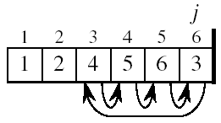
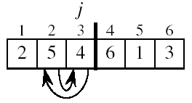
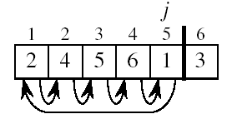
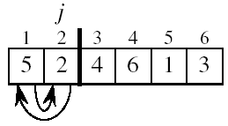
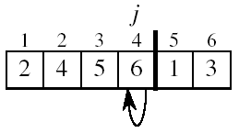
Insertion Sort
5 2 4 6 1 3
2 5 4 6 1 3
2 4 5 6 1 3
2 4 5 6 1 3
1 2 4 5 6 3
1 2 3 4 5 6

Slide 38
INSERTION-SORT
1
2
3
4
5
6
7
8
Alg.: INSERTION-SORT(A)
for j ← 2 to n
do key ← A[ j ]
Insert A[ j ] into the sorted sequence A[1 . . j -1]
i ← j - 1
while i > 0 and A[i] > key
do A[i + 1] ← A[i]
i ← i – 1
A[i + 1] ← key
Insertion sort – sorts the elements in place
a₁
a₂
a₃
a₄
a₅
a₆
a₇
a₈
key
it rearranges the numbers within the array A, with at most a constant number of them stored outside the array at any time

Slide 39
Loop Invariant for Insertion Sort
Alg.: INSERTION-SORT(A)
for j ← 2 to n
do key ← A[ j ]
Insert A[ j ] into the sorted sequence A[1 . . j -1]
i ← j - 1
while i > 0 and A[i] > key
do A[i + 1] ← A[i]
i ← i – 1
A[i + 1] ← key
Invariant: at the start of the for loop the elements in A[1 . . j-1] are in sorted order

Slide 40
Proving Loop Invariants
Proving loop invariants works like induction
Initialization (base case):
It is true prior to the first iteration of the loop
Maintenance (inductive step):
If it is true before an iteration of the loop, it remains true before the next iteration
Termination:
When the loop terminates, the invariant gives us a useful property that helps show that the algorithm is correct
Stop the induction when the loop terminates

Slide 41
Loop Invariant for Insertion Sort
Initialization:
Just before the first iteration, j = 2:
the subarray A[1 . . j-1] = A[1], (the element originally in A[1]) – is sorted

Slide 42
Loop Invariant for Insertion Sort
Maintenance:
the while inner loop moves A[j -1], A[j -2], A[j -3], and so on, by one position to the right until the proper position for key (which has the value that started out in A[j]) is found
At that point, the value of key is placed into this position.

Slide 43

Loop Invariant for Insertion Sort
Termination:
The outer for loop ends when j = n + 1 ⇒ j-1 = n
Replace n with j-1 in the loop invariant:
the subarray A[1 . . n] consists of the elements originally in A[1 . . n], but in sorted order
The entire array is sorted!
j - 1
j

Slide 44
Analysis of Insertion Sort
INSERTION-SORT(A)
for j ← 2 to n
do key ← A[ j ]
Insert A[ j ] into the sorted sequence A[1 . . j -1]
i ← j - 1
while i > 0 and A[i] > key
do A[i + 1] ← A[i]
i ← i – 1
A[i + 1] ← key
cost times
c₁ n
c₂ n-1
0 n-1
c₄ n-1
c₅
c₆
c₇
c₈ n-1
t_{j}: # of times the while statement is executed at iteration j
Notes:
₇

Slide 45
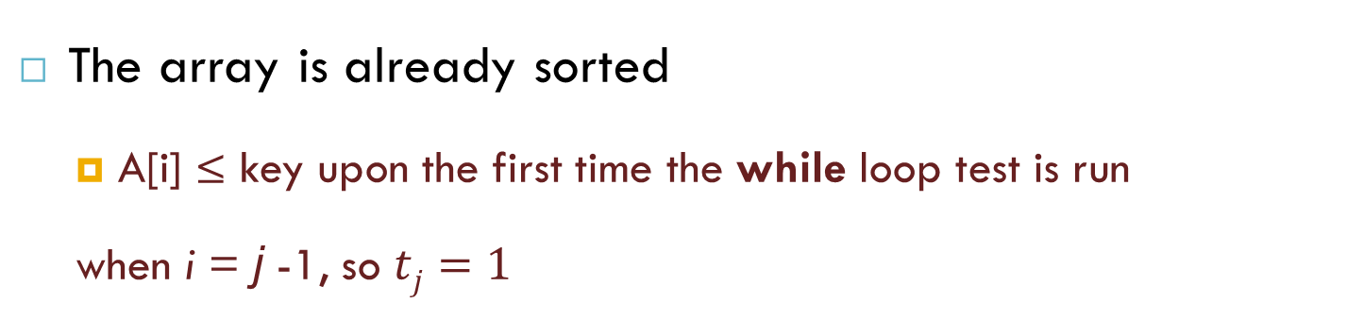
Best Case Analysis
The array is already sorted
A[i] ≤ key upon the first time the while loop test is run
when i = j -1, so $tj=1$
“while i > 0 and A[i] > key”
1 0 0
T(n) = c₁n + c₂(n -1) + c₄(n -1) + c₅(n -1) + c₈(n-1)
= (c₁ + c₂ + c₄ + c₅ + c₈)n + (c₂ + c₄ + c₅ + c₈)
= an + b = Θ(n)

Slide 46
Worst Case Analysis
The array is in reverse sorted order
Always A[i] > key in while loop test
Have to compare key with all elements to the left of the j-th position ⇒ compare with j-1 elements ⇒ t_{j} = j
a quadratic function of n
T(n) = Θ(n²) order of growth in n²
“while i > 0 and A[i] > key”

Slide 47
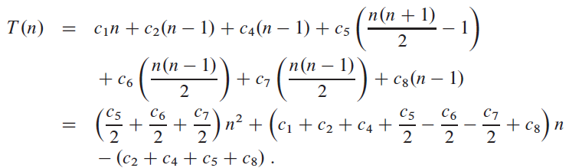
Worst Case Analysis
a quadratic function of n
T(n) = Θ(n²) order of growth in n²

Slide 48
Insertion Sort - Summary
Advantages
Good running time for “almost sorted” arrays Θ(n)
Disadvantages
Θ(n²) running time in worst and average case
≈ n²/2 comparisons and exchanges

Slide 49
Reference
Algorithm Design: Foundations, Analysis, and Internet Examples. Michael T. Goodrich and Roberto Tamassia. John Wiley & Sons.
Introduction to Algorithms. Thomas H. Cormen, Charles E. Leiserson, Ronald L. Rivest, Clifford Stein.

Slide 50
Thank you!

